Slide 1
Project notes/Surveying by GPS II.
PROJECT NOTES
OBJECTIVE: The purpose of this semester project is for you to gain some more experience in using GPS equipment in the field and GIS software in the lab. The project breaks down into 4 steps:
1. Using a GPS receiver to map an assigned parking lot on campus.
APPENDIX 1: MAPPING ASSIGNMENTS
⁽see campus parking map: https://experience.arcgis.com/experience/5b6f7d38a75b4f6e84c81eae31216267/?draft=true)
for parking lot locations.
Rachel Black | 4
Kris Correa | 5
Laine Hickle | 8
Raphaela Leo | 11
Aletris Oles | 14
Damien Phillips | 13
Jacquelin Sanchez | 17
Kaden Snider | 15

Slide 2
2. Obtaining an air photo backdrop from Google Earth Pro for your GIS map.

Slide 3
3. Registering the air photo image using Ground Control Points.

Slide 4
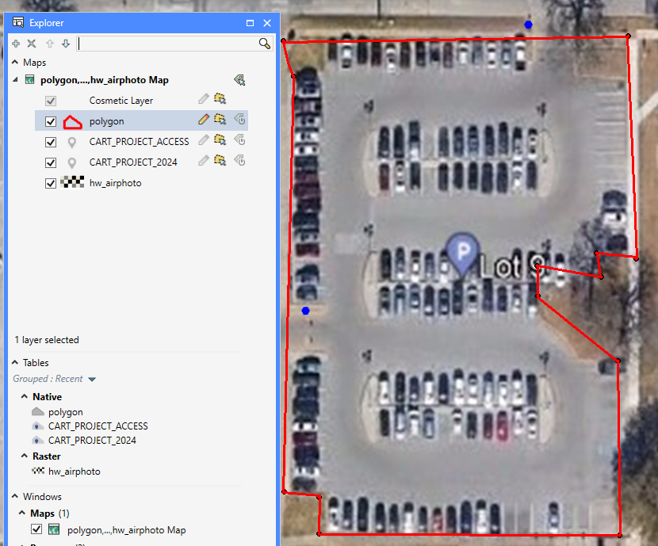
4. Collecting Points and creating a polygon..

Slide 5
5. Using MapInfo Pro software to create a GIS map of your parking lot showing area and perimeter.

Slide 6
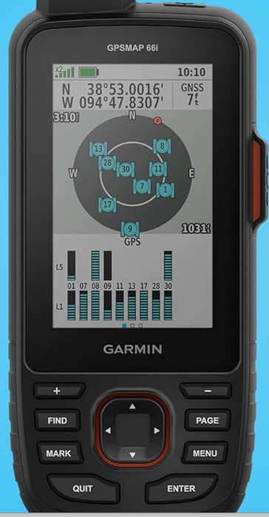
When you do the project, you might notice that the Garmin’s estimated accuracy is around 10-15 feet.
The Garmin shows you Lat and Long, GNSS enabled, estimated error, satellite number and location and signal strength.

Slide 7
For class (can’t move on until questions are answered):
When would 10-15 feet of error be OK?
When would 10-15 feet of error not be OK?

Slide 8
How do we improve error?
RTK is short for real time kinematics. A receiver capable of RTK takes in the normal signals from the Global Navigation Satellite System along with a correction stream (radio signal) to achieve 1cm positional accuracy.
https://www.youtube.com/watch?v=257WX_agvtg

Slide 9
Differential Correction. Boosts GPS positional accuracy - based on the use of a benchmark. The idea is to position a permanent GPS base station in a precisely known location. Using the resulting base files (an error signal), the receiver files (or rover files) can be differentially corrected; this means that the offset due to error at the base station (which is found by comparing the base station's known position to its GPS-calculated position) can be applied to GPS positions collected in the field.
After differential correction, GNSS receivers are claimed to reduce errors to <1cm.
But, there’s something we need first – the base files (error signal). Where do you get them? There are networks of base stations all over the country; some are private, some are government-run. TXDOT (Texas Department of Transportation) has a network of base stations covering much of Texas; data is online and free to the public.

Slide 10
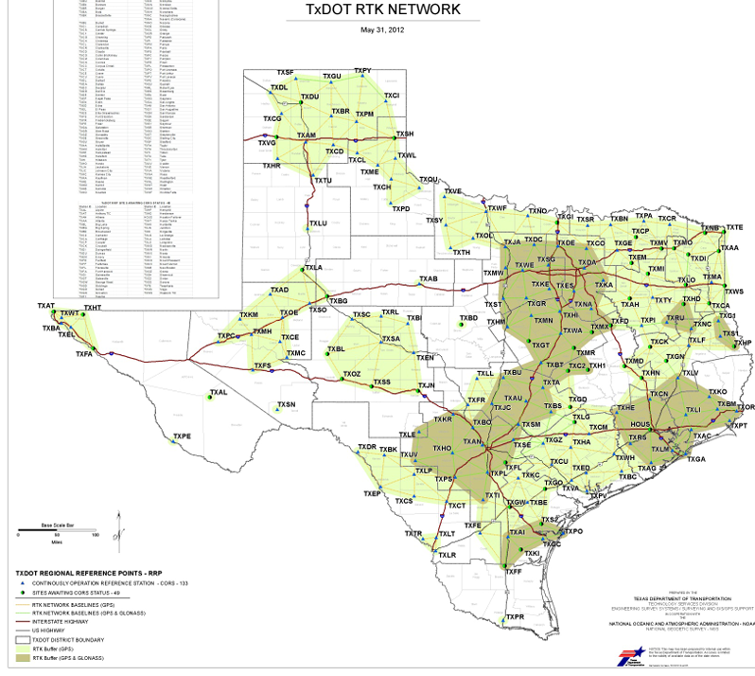
2012

Slide 11
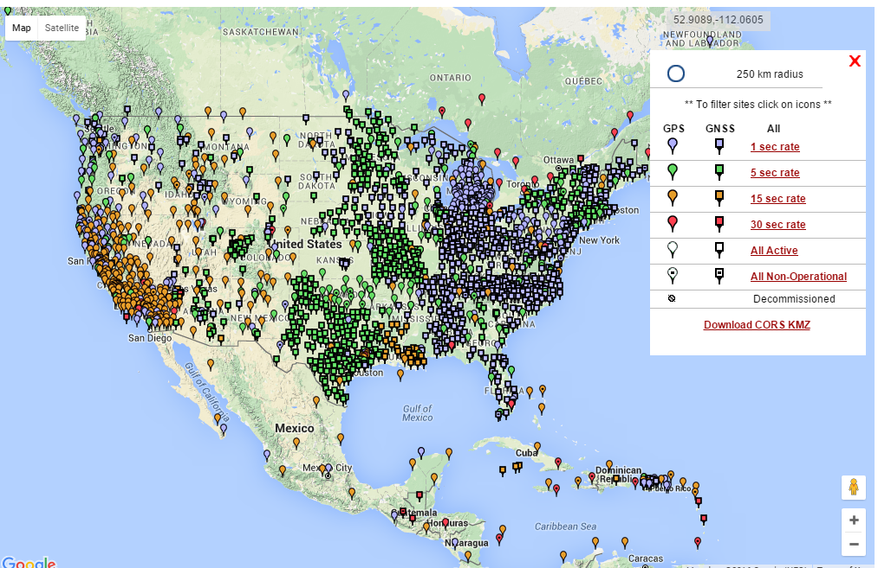

Slide 12
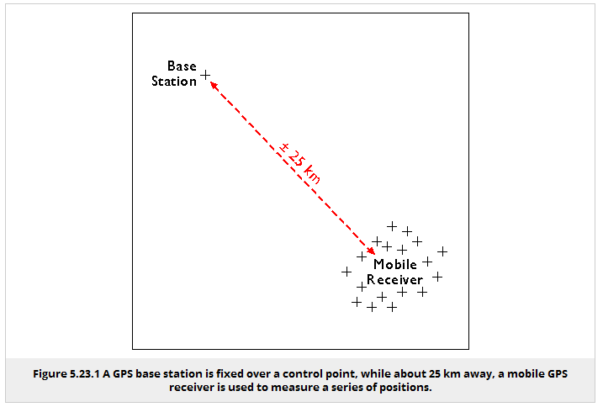

Slide 13
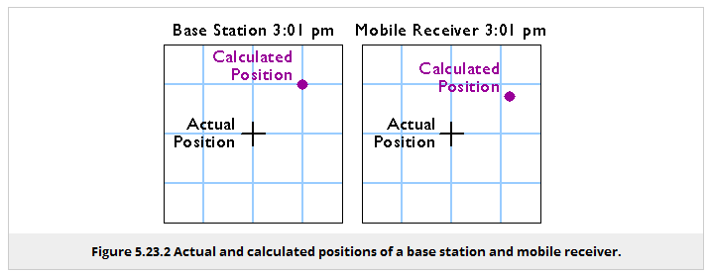
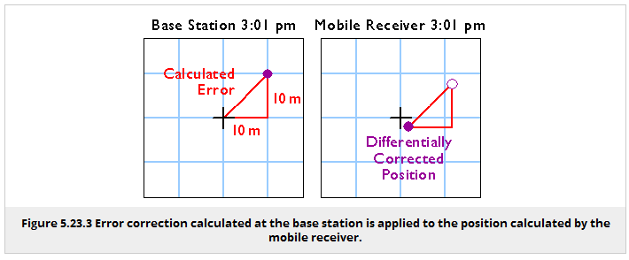

Slide 14
In the lab this week you will create a map of the GPS data collected in Lab 7.

