Slide 1
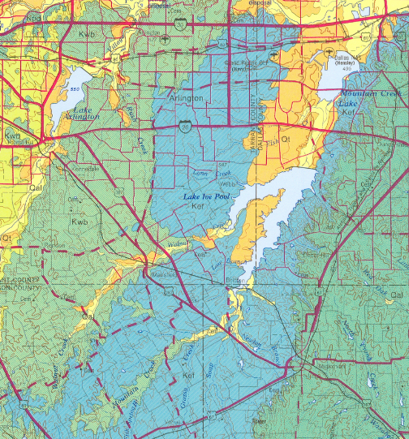
Lab 2 guide.
Three bedrock layers with ~ NE-SW strike: Kwb, Kef, Kau.
Qt, Qal are recent surficial sediments (orange and yellow on map)– ignore these – they are not bedrock.
Law of V’s: these rock layers dip gently to the southeast.

Slide 2
Creeks on the Kau.
A 4th bedrock outcrop can now be seen – Ko.
So, we’re dealing with 4 bedrock outcrops:
Kwb: Woodbine formation (sandstone).
Kef: Eagle Ford Formation (shale).
Kau: Austin Chalk (limestone).
Ko: Ozan formation (marl).

Slide 3
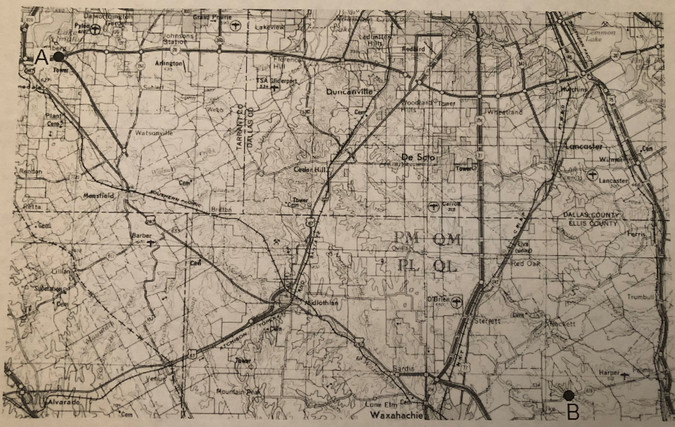
Base line A-B (Note that point A is slightly north of the label “Tower”).

Slide 4
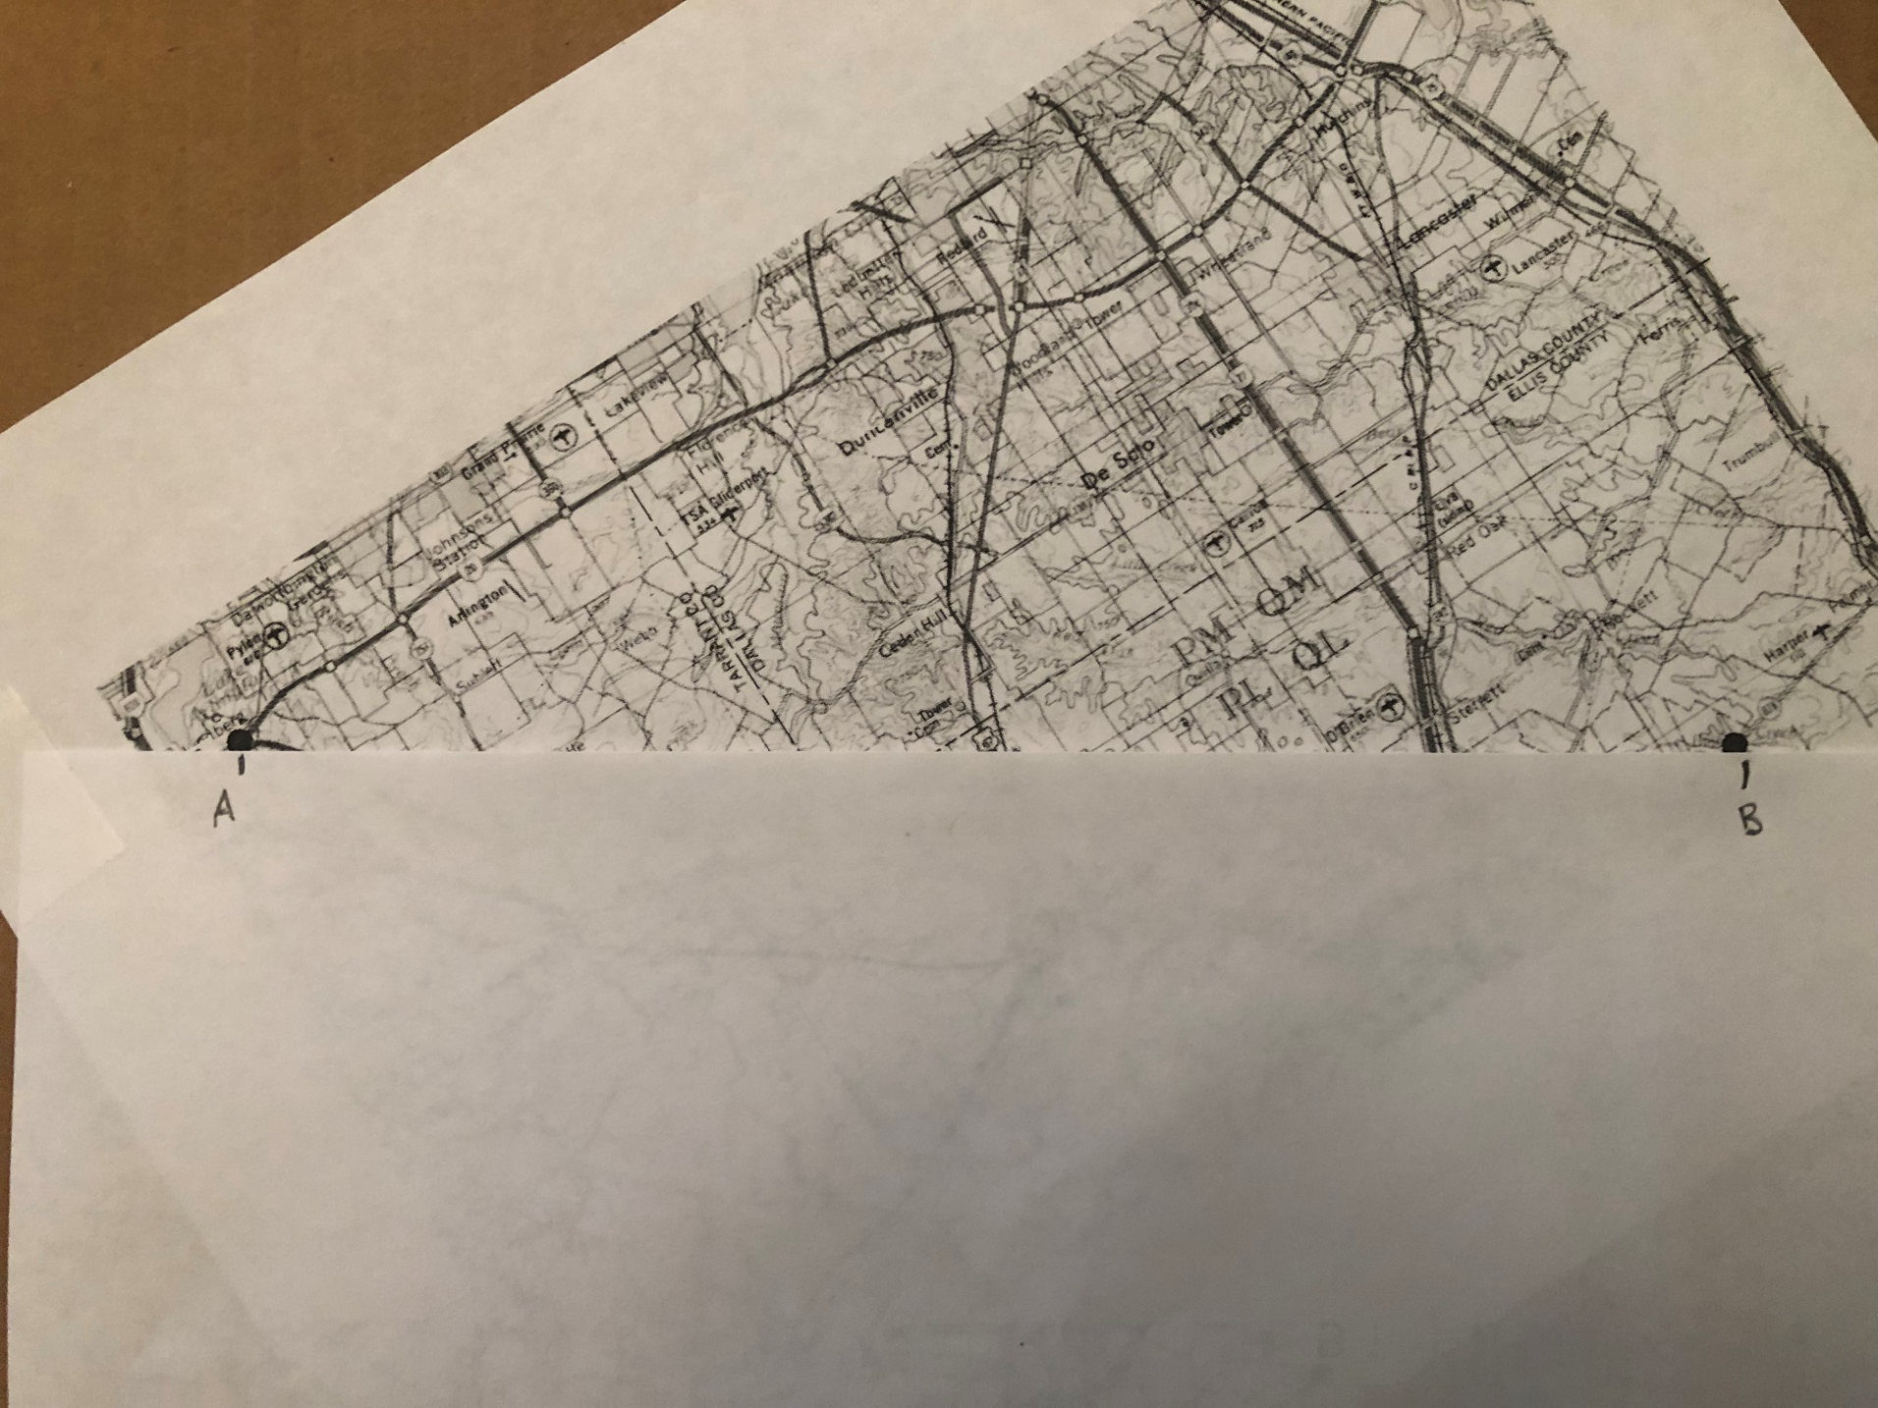
Align paper

Slide 5
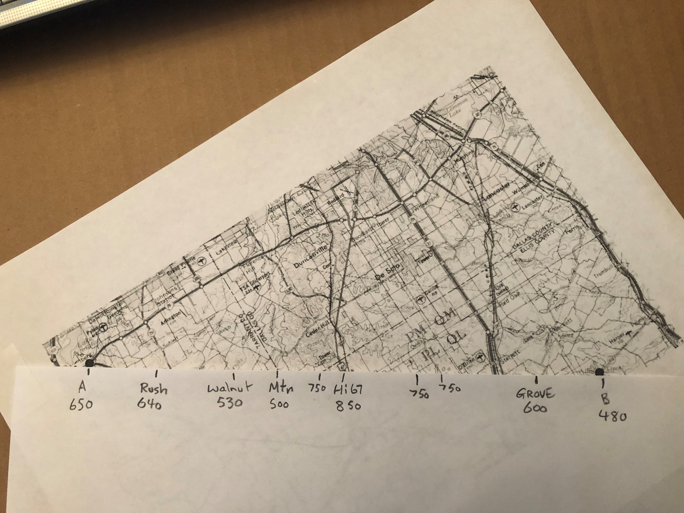
Mark elevations.

Slide 6
Transfer the elevations to the graph paper (only 2 elevations are marked below – do the rest). “Join the dots” to create the topographic profile.

Slide 7
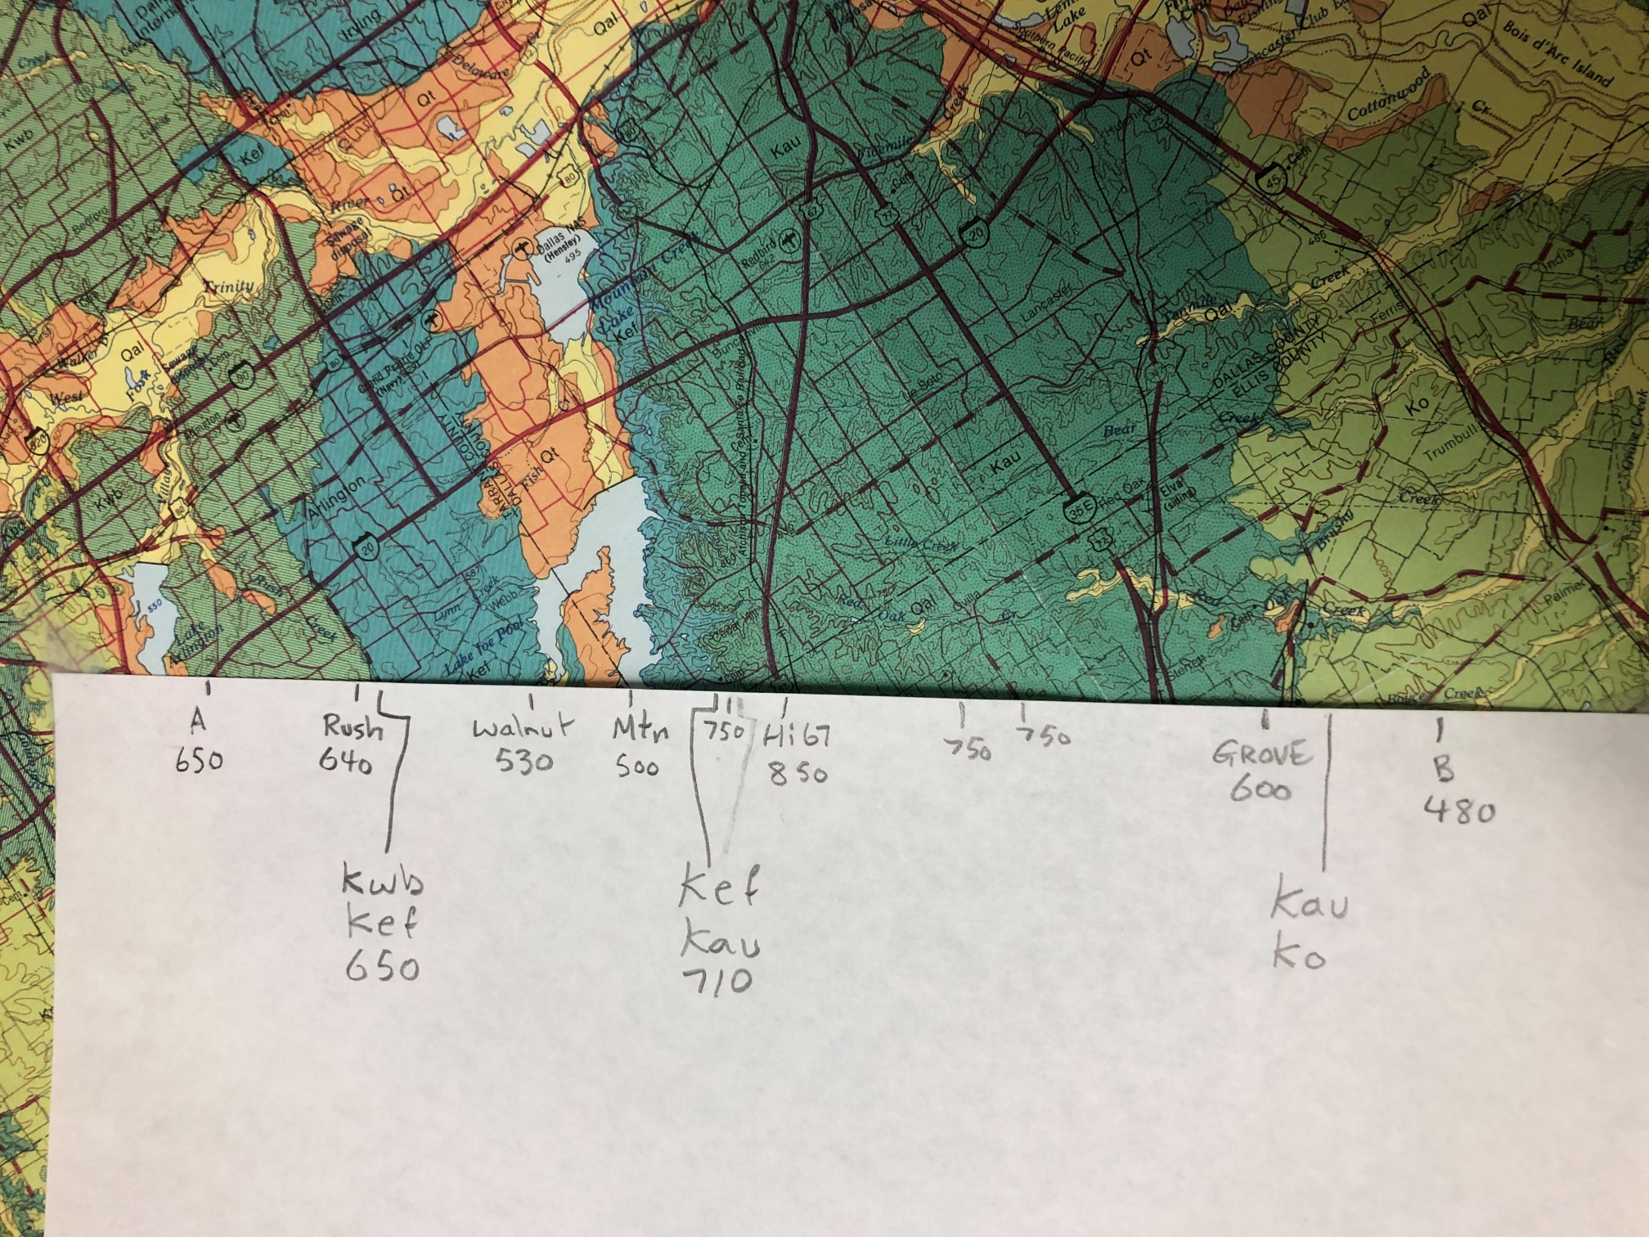
Mark bedrock contacts on profile line.

Slide 8
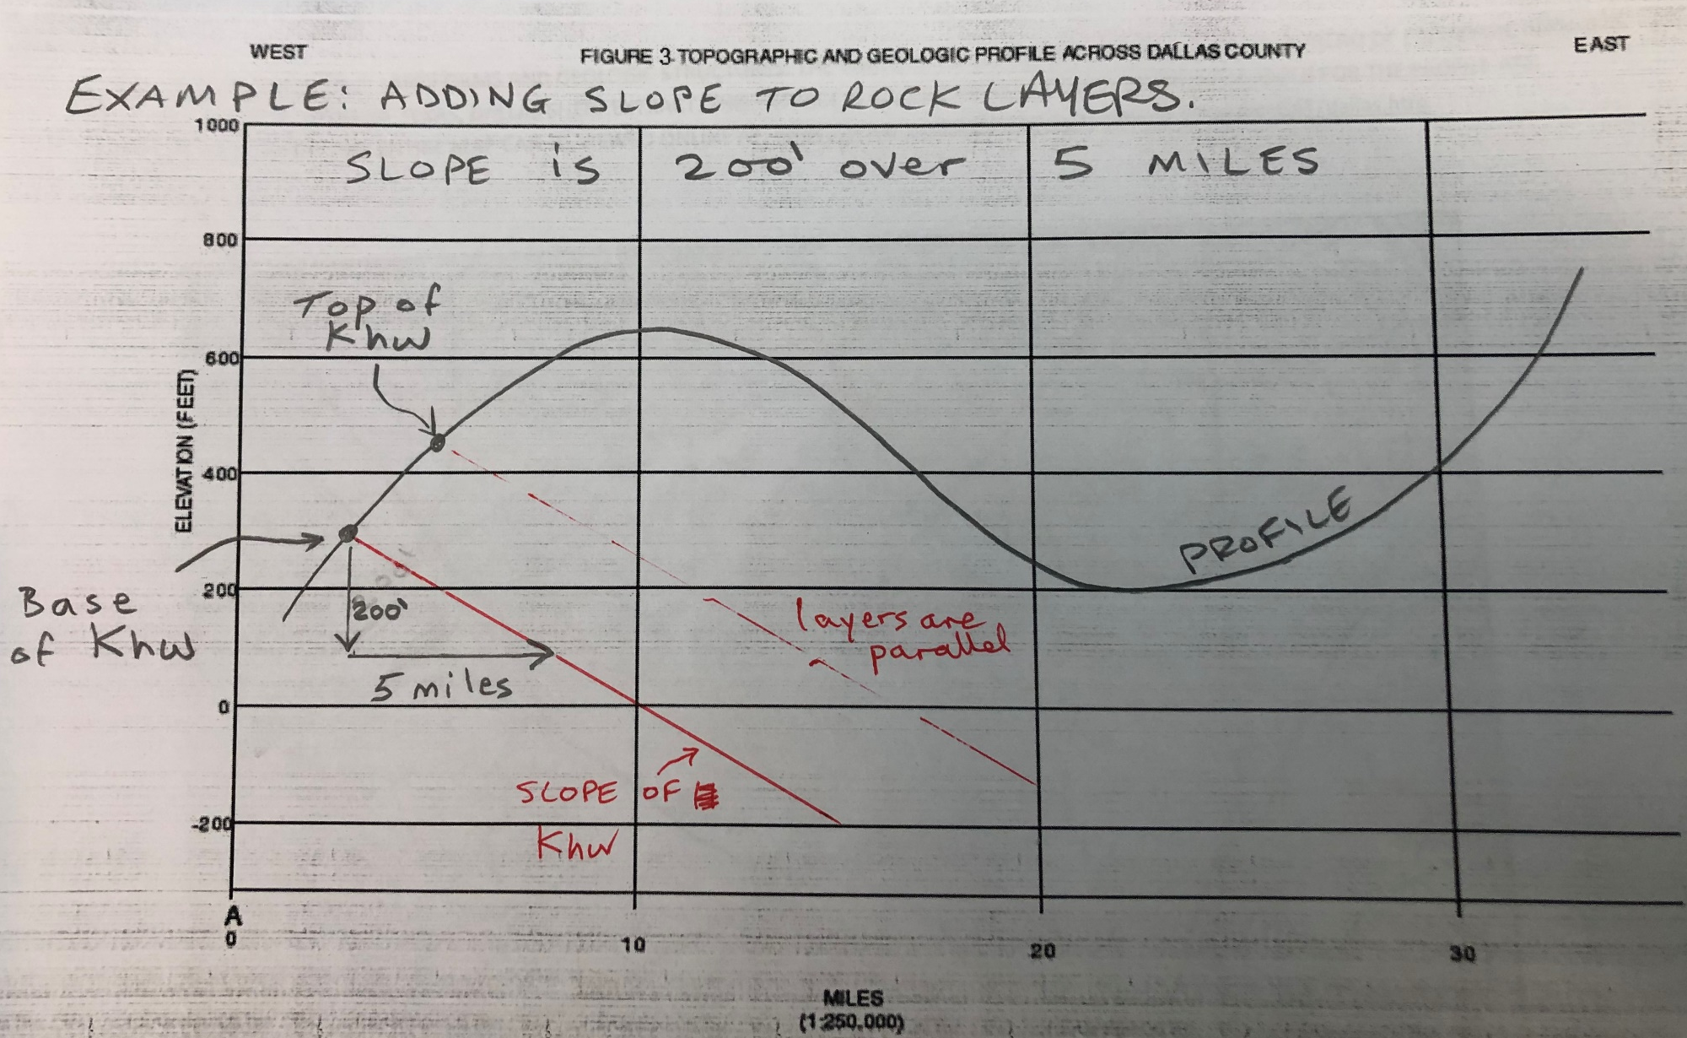
Khw
Note: this is not the actual profile – just a made up example. In this example, slope is 200’ over 5 miles. The actual slope is 275’ over 10 miles. Example simply illustrates how slope is added to profile.

